Slide 1
A 2015 Social Accounting Matrix for Ghana
Technical presentation
Official launch
16 November 2017

Slide 2
Outline of the Presentation
Overview
Introduction of the 2015 Ghana SAM
Questions and answers
Way forward

Slide 3
Overview

Slide 4
In this Overview section, we will explain
What is a SAM
Uses of a SAM
The Partners
Objectives of the Project

Slide 5
What is a Social Accounting Matrix?
A SAM is a data representation of an economy/region at a point in time in matrix form
It represents the monetary flows of all economic transactions in the economy/region
Thereby capturing the interactions between all different markets and institutions
Providing a consistent and detailed economywide view of a country
The 2015 National Ghana SAM uses the most recent data and provides an overview of the current known structure of the Ghana economy

Slide 6
Why is a SAM useful?
A SAM is benchmarked on official national accounts and other country statistics; it adheres to economic accounting principles which ensures internal consistency
Microeconomic data aggregates to macroeconomic statistics
All macroeconomic balances are maintained
It is an efficient format for describing the structure of the economy
Captures interlinkages between firms, households, government and non-government institutions
As a database, the SAM is useful for economywide modelling and policy analysis
Detailed sectoral structures allow for assessment of value chain impacts, e.g. production and employment
Link to macro-aggregates and socio-economic concerns enable reporting on policy relevant information, e.g. GDP and income distribution
Social accounts permit inferences on distributional or poverty effects of policy shocks

Slide 7
2015 National Ghana SAM Development
ISSER
Convenor
GSS
Data
Capacity building
IFPRI
Technical support
Notes:
Joint initiative between the GSS, ISSER and IFPRI

Slide 8
2015 National Ghana SAM Development
Ghana SAM forms part of the Nexus Project funded by the CGIAR and led by IFPRI
Objective of the project is to establish common data standards, procedures and classification systems for constructing and updating national SAMs used for country-level computable general equilibrium (CGE) modeling
Developed using the IFPRI SAM Building Toolkit
Simple, efficient and transparent method for building and updating country SAMs
Reconciles data from multiple sources; core tailored to national statistical reports
Final data reconciliation uses cross-entropy estimation
Coded in Microsoft Excel® and GAMS®

Slide 9
Introducing the SAM

Slide 10
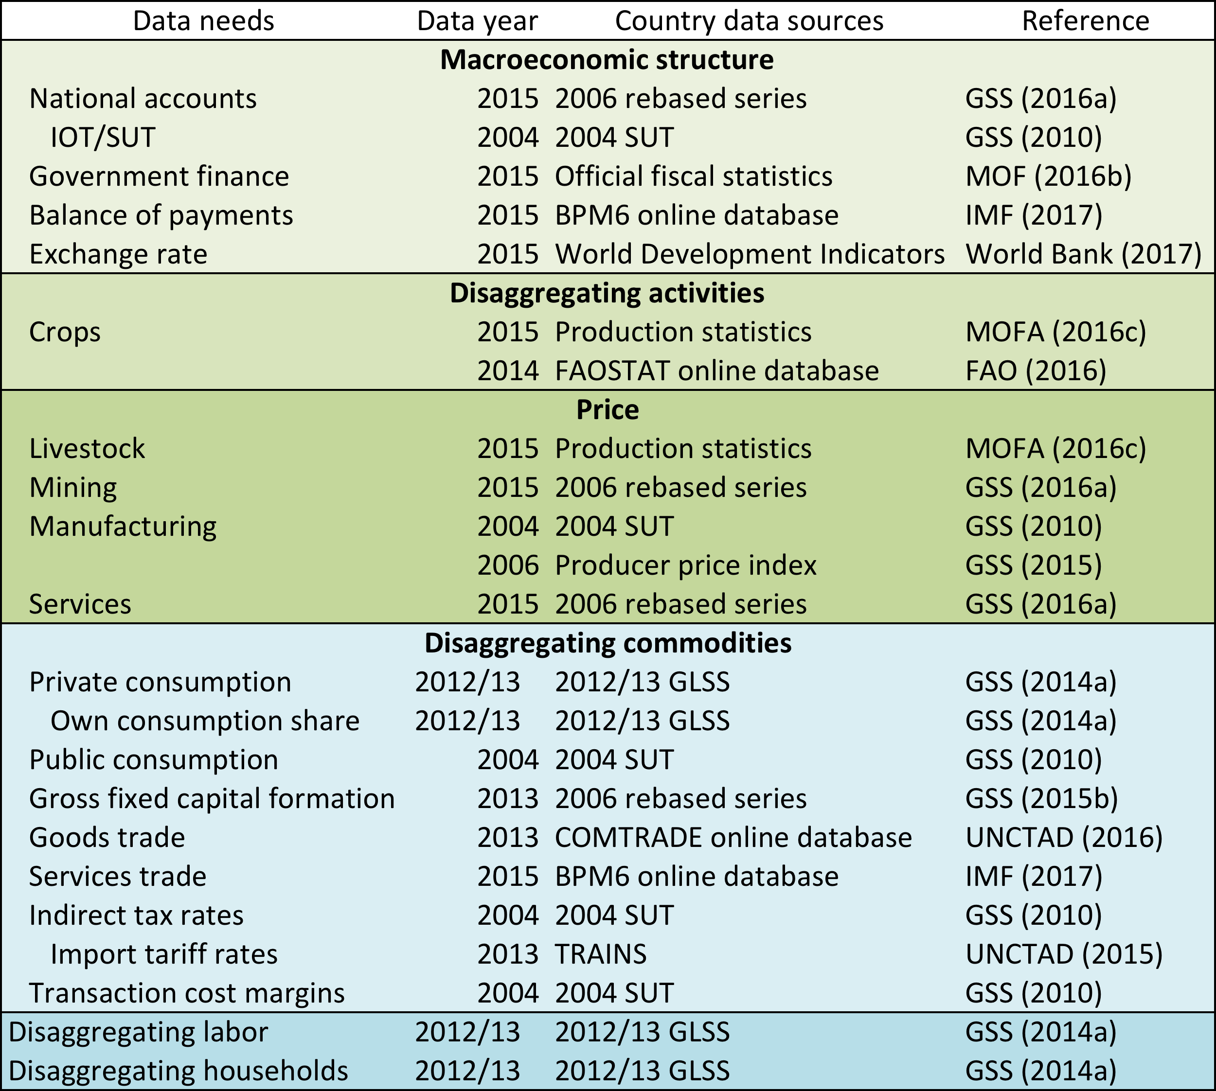
2015 National Ghana SAM Data sources
Standardized concordance between SAM
and classification systems
GFS2001 and BOP6 → SNA 1993 → Macro SAM accounts
ISIC3.1, ISIC4, HS2007, COICOP → Disaggregated SAM accounts
Inconsistent values across sources requires reconciliation
Consistency with national accounts afforded highest priority, followed by BOPs and GFS

Slide 11
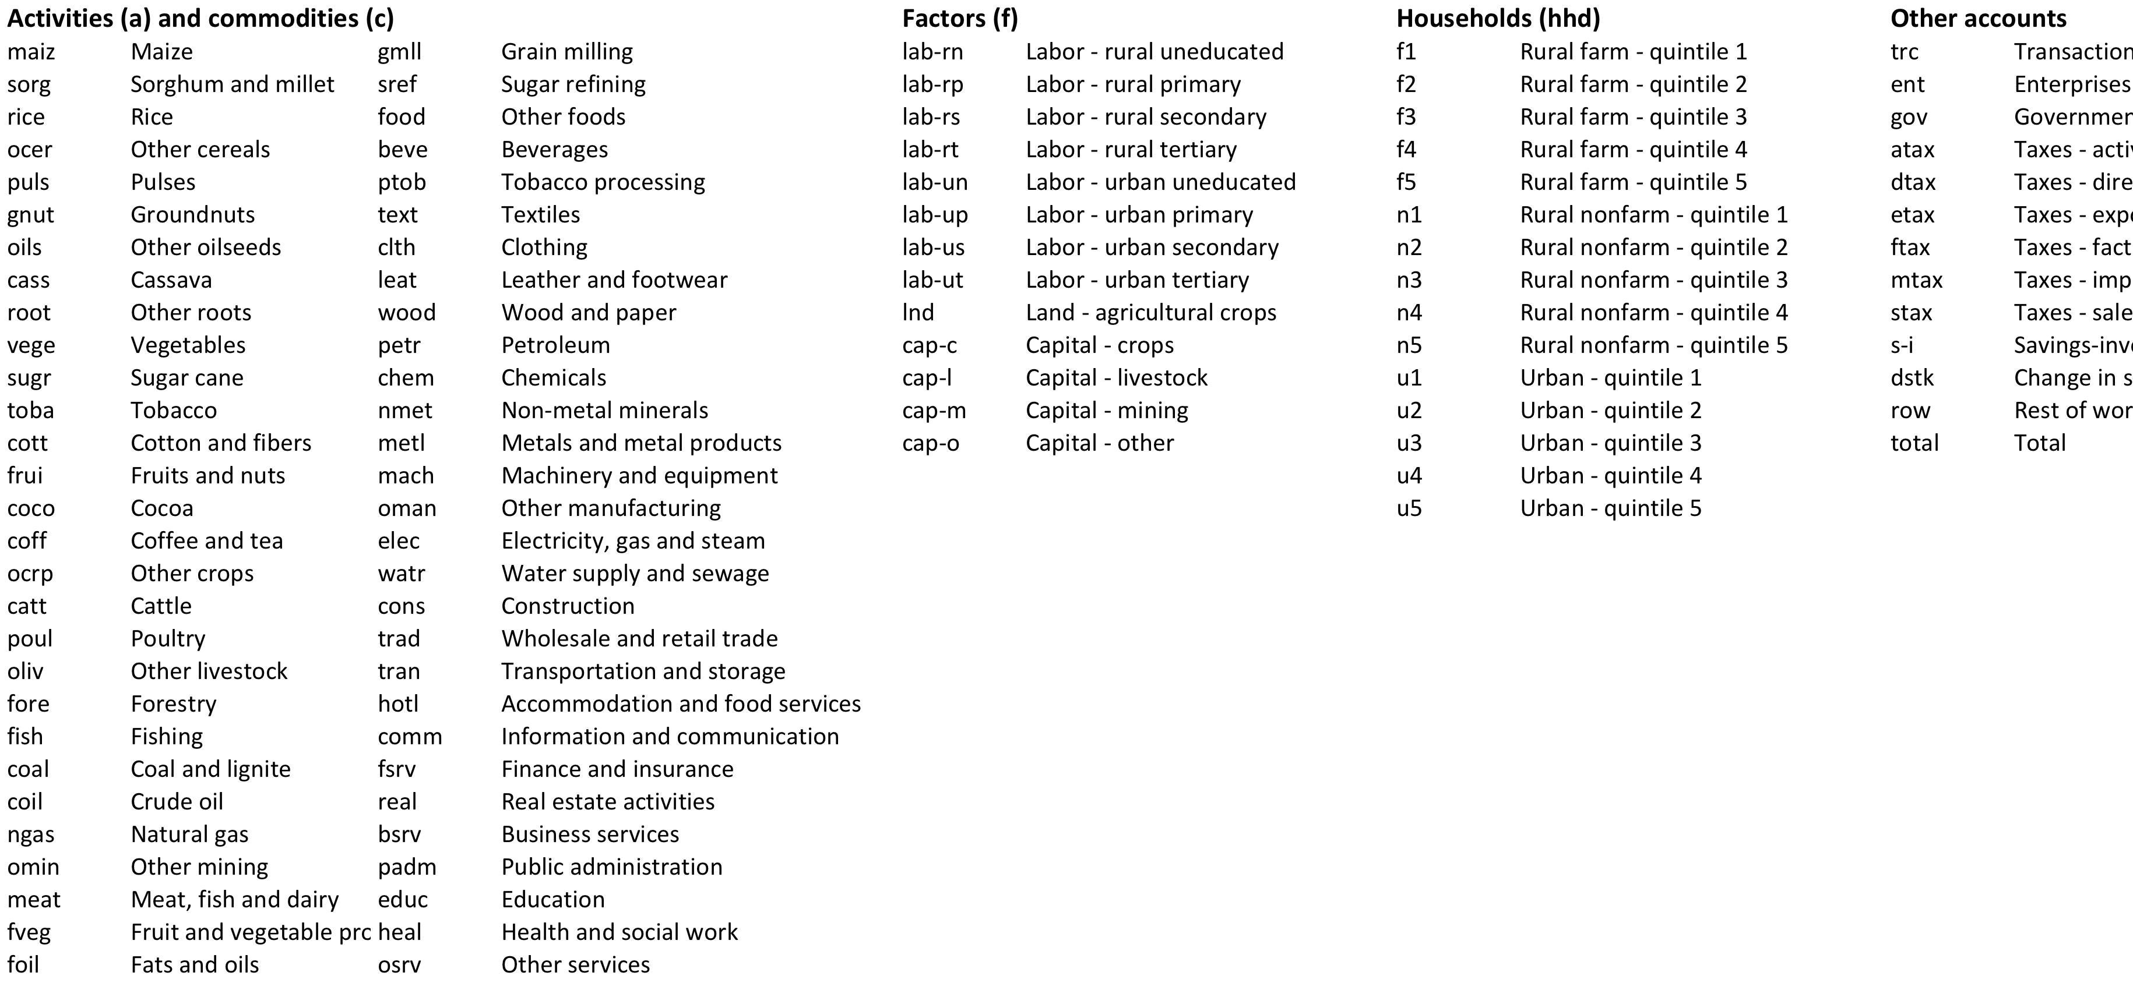
2015 National Ghana SAM Accounts
8 labour groups
rural/urban; education type
Agriculture land for crops
4 capital groups
crop; livestock; mining; other
15 household groups
rural (farm/non-farm), urban
expenditure quintile
Other accounts
55 activities; 56 commodities
Agriculture (21); Industry (23); Services (11)

Slide 12
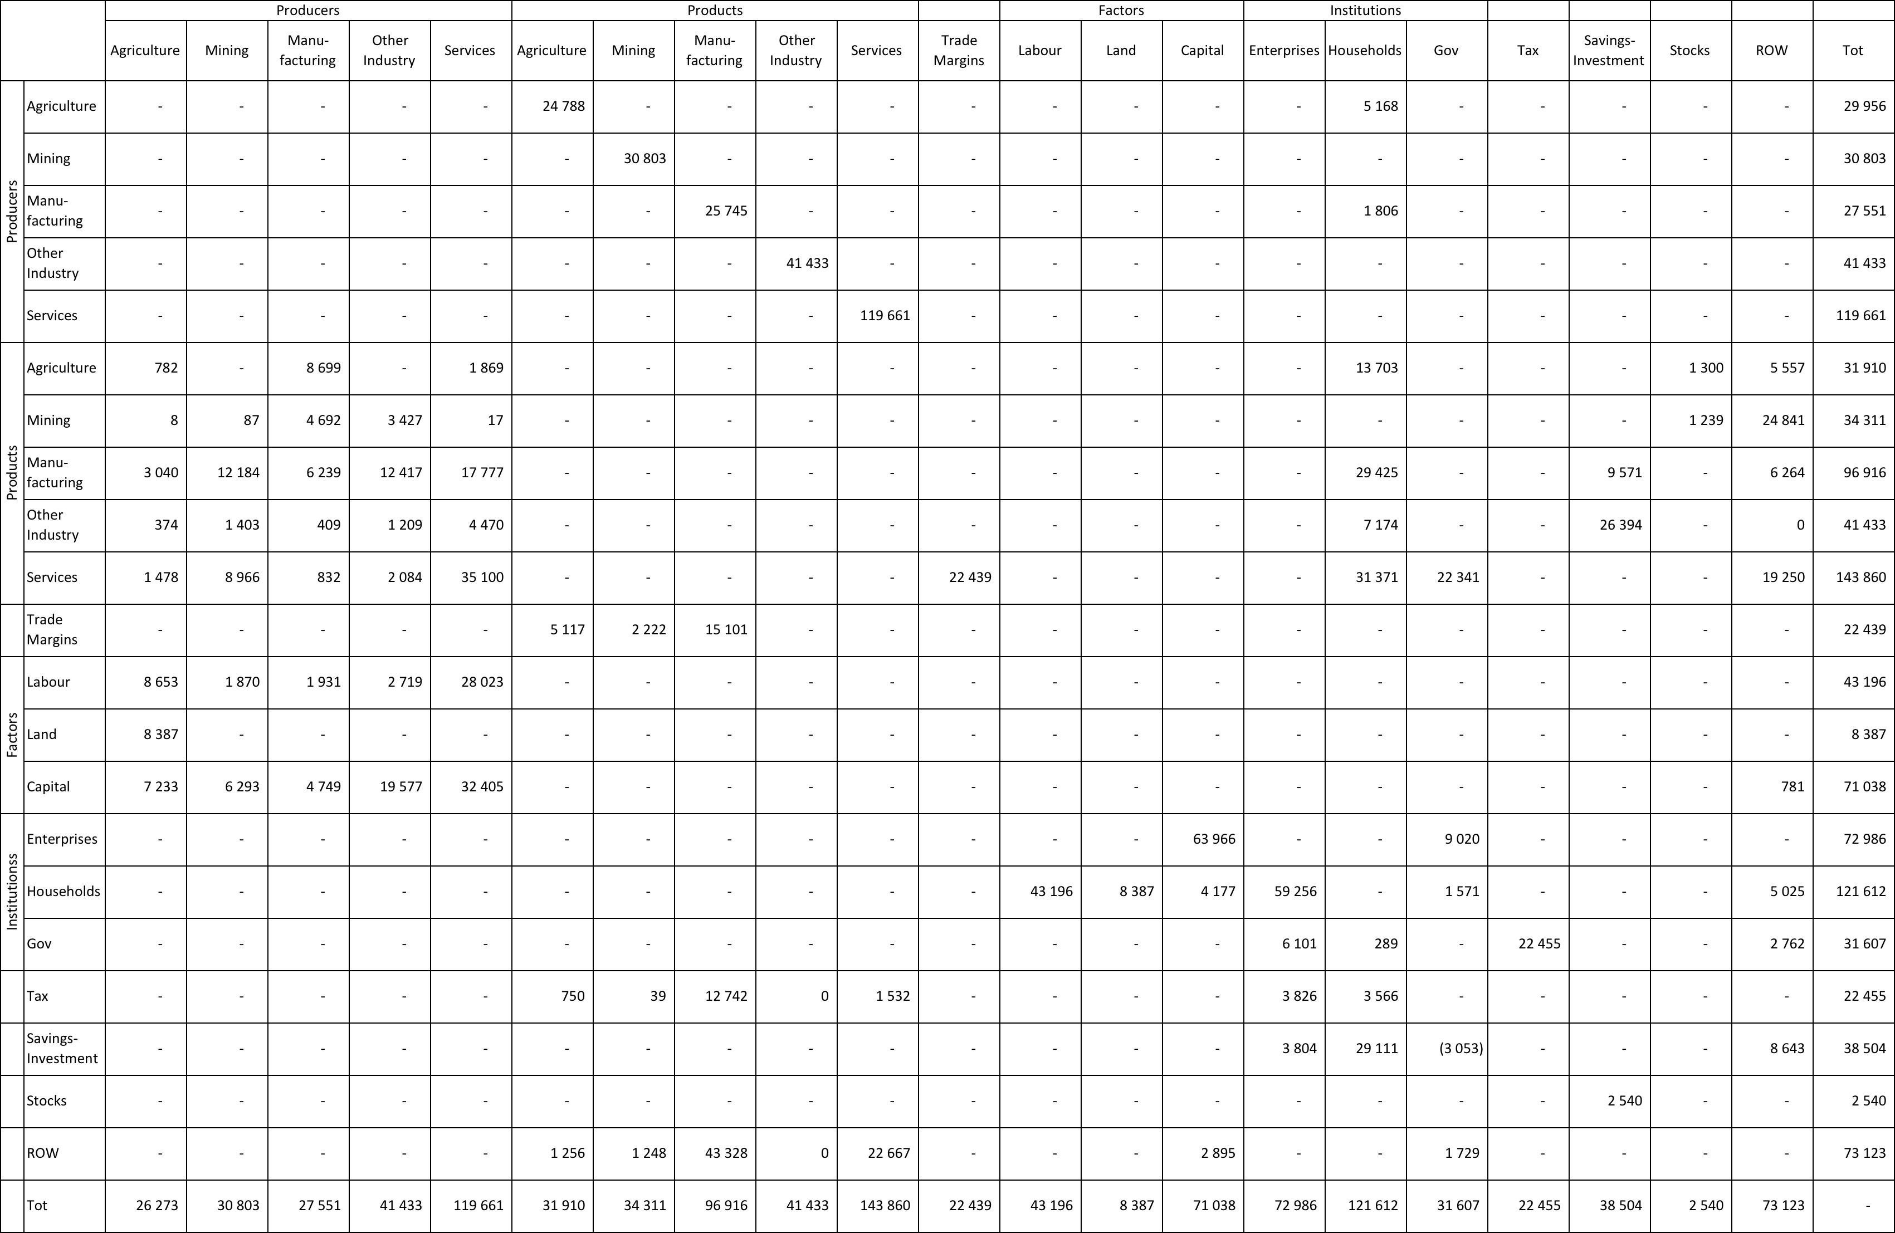
2015 National Ghana SAM
Input-Output Matrix
Payments
Incomes
Million GHC
Notes:
Columns=payments
Rows=income

Slide 13
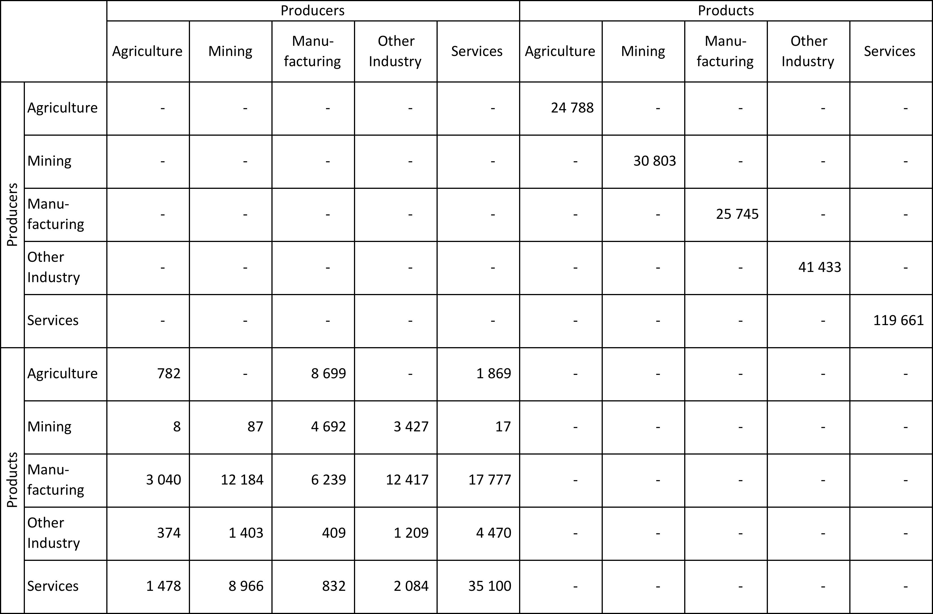
Input-Output Matrix
Table shows aggregate producers and products
→ SAM contains a number of different producers and products
Producers are the firms/companies that produce goods and services…
…Commodities are those goods and services produced by activities
→ separated: firms/companies may produce may more than one kind of commodity; commodities can be produced by more than one type of producer
→ Nexus SAMs assume only one producer and one commodity
Producers produce goods and services by combining the factors of production with intermediate inputs
→ Intermediate demand
→ Capture interlinkages between sectors
Million GHC

Slide 14
2015 National Ghana SAM
Value Added / Gross Domestic Product at FC
Million GHC

Slide 15
Value Added
Producers produce goods and services by combining the factors of production with intermediate inputs
→ Factors of production
Producers pay wages, rents, and profits generated during the production
= value added (GDP at factor prices)
2015 = ~GHC 122 billion
Indicates labour, land, capital intensities
For example: Mining sector is very capital intensive; Agriculture is more labour intensive
Expansions in agriculture would therefore directly favour labour incomes, while in mining they would favour capital incomes
Million GHC

Slide 16
2015 National Ghana SAM
Household
Expenditure
Household
Income
Million GHC
Notes:
A SAM is different from an input–output matrix because it not only traces the income and expenditure flows of producers and productss, but it also contains complete information on different institutional accounts. One such institution is households.
Information in household accounts is usually drawn from national accounts and household surveys.

Slide 17
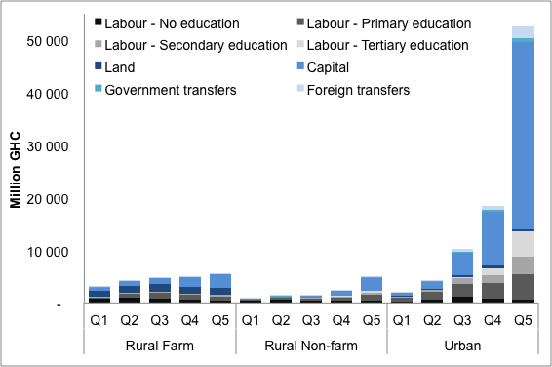
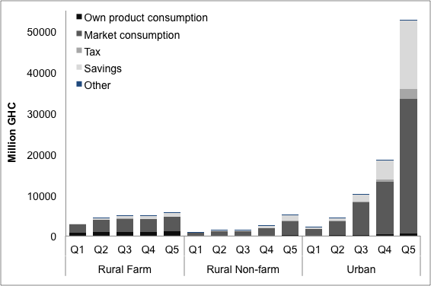
Households
Income
Expenditure
Notes:
Households are usually the ultimate owners of the factors of production, and so they receive the incomes earned by factors during the production process. They also receive transfer payments from the government (for example, social security and pensions) and from the rest of the world (such as remittances received from family members working abroad).
Talk to graph.
Households pay taxes directly to the government and purchase products. The remaining income is then saved.
Talk to graph.

Slide 18
2015 National Ghana SAM
Government
Expenditure
Government
Income
Million GHC
Notes:
Information on the government accounts is normally drawn from public-sector budgets published by a country’s ministry of finance.

Slide 19
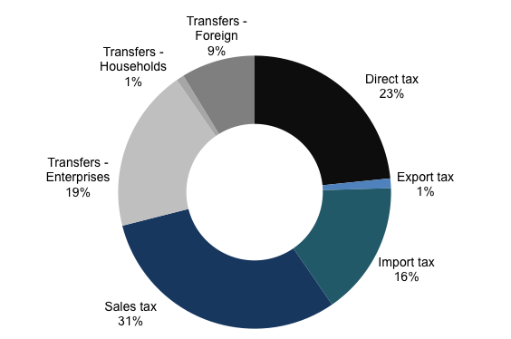
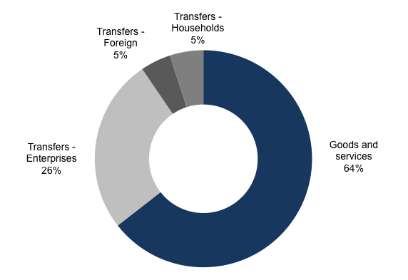
Government
Income
Expenditure
Deficit
3 053
Total = 31 607
Total = 34 660
Notes:
The government receives transfer payments from the rest of the world such as foreign grants and development assistance). This is added to all of the different tax incomes to determine total government revenues.
Talk to graph.
The government uses these revenues to pay for recurrent consumption spending and transfers to households.
Talk to graph.
The difference between total revenues and expenditures is the fiscal surplus (or deficit, if expenditures exceed revenues).

Slide 20
2015 National Ghana SAM
Foreign receipts
Foreign payments
Million GHC
Notes:
Information on the current account (or rest of world) is drawn from the balance of payments, which is usually published by a country’s central bank.

Slide 21
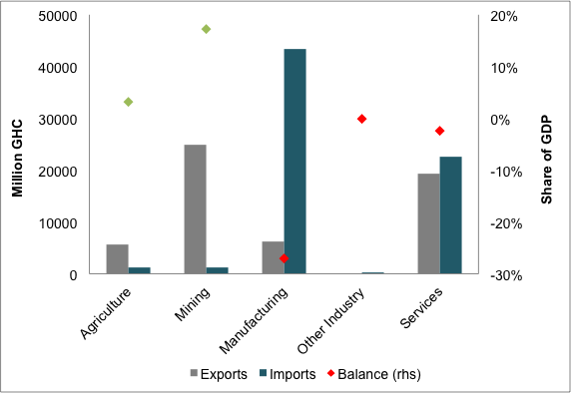
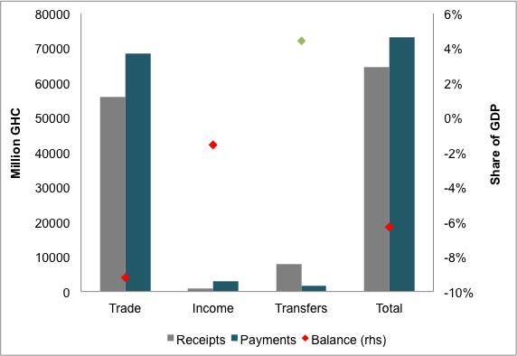
Foreign receipts and payments
Current account balance
= -6% of GDP
Trade
Current Account
Foreign savings
= 8 643
Notes:
Transactions with the rest of the world include the trade of goods and services, income receipts and payments and transfers.
Trade = exports and imports
Balance
Adding into account income receipts and payments; and transfers gives us the current account.
Talk to graph on the left.
Current account balance
Foreign savings

Slide 22
Regional SAM
A preliminary regional SAM has also been produced; not currently part of the official release
The regional SAM follows same macroeconomic structure as national SAM
But disaggregates households, factors of production, and activities by “north” and “south”
Useful for analyses of policies targeted towards northern area development; also captures inter-regional linkages (or spillover effects)

Slide 23
Q & A

Slide 24
Way forward

Slide 25
Way forward
2015 National Ghana SAM and documentation available online
www.statsghana.gov.gh
Significant new data releases in 2018
Ghana Living Standard Survey 2016/17 (GLSS7) (June 2018)
GDP rebasing exercise (May 2018)
New Supply and Use Tables (May 2018)
Agricultural Census (Phase 2: Production Estimates) (October 2018)
New data warrants SAM update
SAM building team will meet in June 2018 to assess new data and commence data analysis
Update of SAM to 2016 or 2017 base year targeted for December 2018
Collaboration will continue to emphasize capacity building within GSS to utilize SAM Building Toolkit

Slide 26
Thank you

